Slide 1
MIPS processor Simulator including Tomasulo
Team 2: Junfei Wang, Jianyun Miao, Nengxing Shen

Slide 2
Tomasulo’s algorithm
Presentor: Nengxing Shen

Slide 3
Tomasulo’s algorithm
Tomasulo's algorithm is a computer architecture hardware algorithm for dynamic scheduling of instructions that allows out-of-order execution and enables more efficient use of multiple execution units.
The major innovations of Tomasulo’s algorithm include register renaming in hardware, reservation stations for all execution units, and a common data bus (CDB) on which computed values broadcast to all reservation stations that may need them.

Slide 4
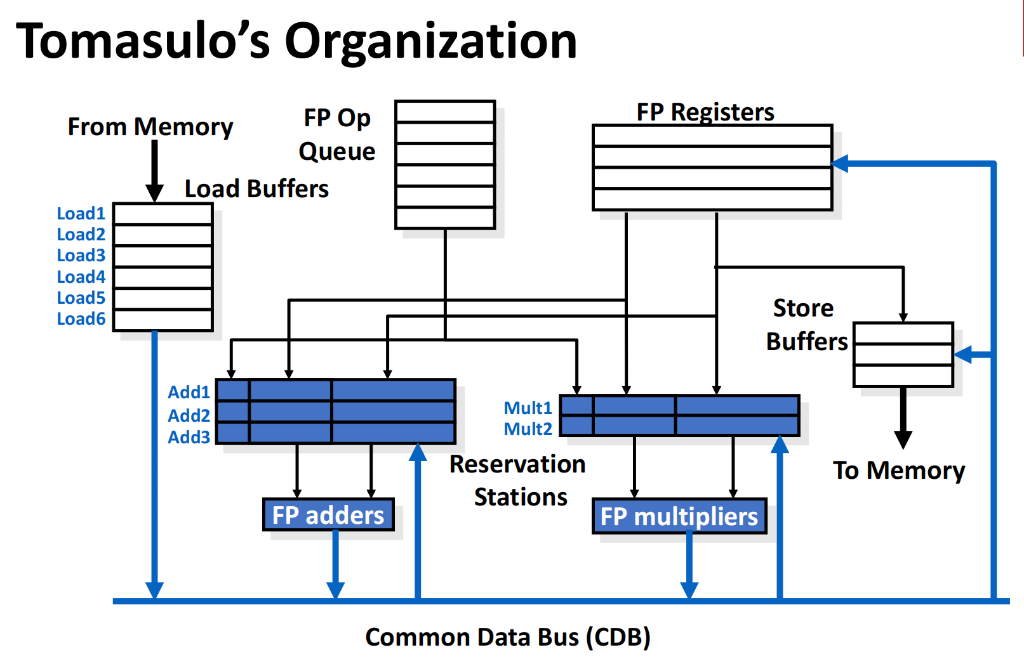

Slide 5
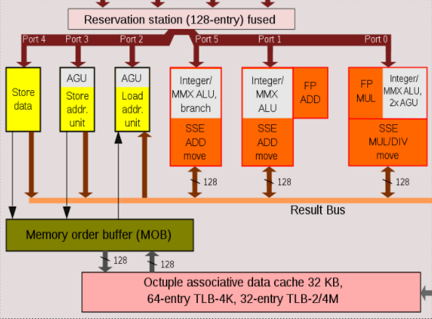
Reservation Stations
Reservation station in Intel's Nehalem microarchitecture
Reservation Station(RS): Functional Unit with its own buffers and its own local control.

Slide 6
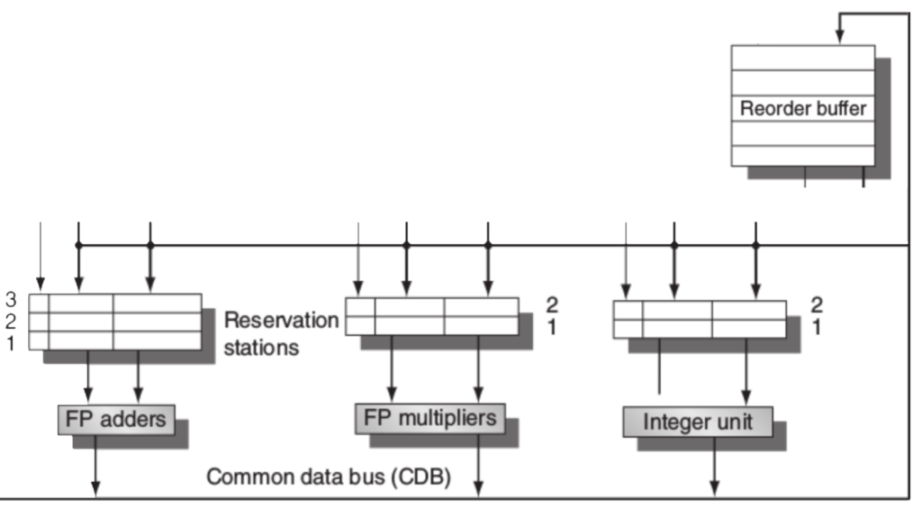
Common Data Bus
The Common Data Bus (CDB) connects reservation stations directly to functional units.

Slide 7
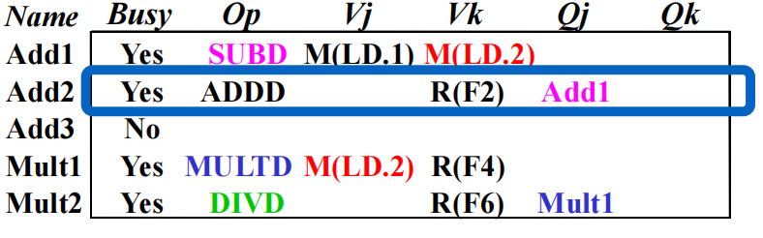
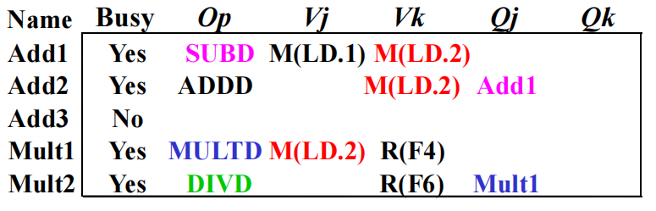
Reigister Renaming
Register renaming is a form of pipelining that deals with data dependences between instructions by renaming their register operands.

Slide 8
multi-issue
Presentor: Jianyun Miao

Slide 9
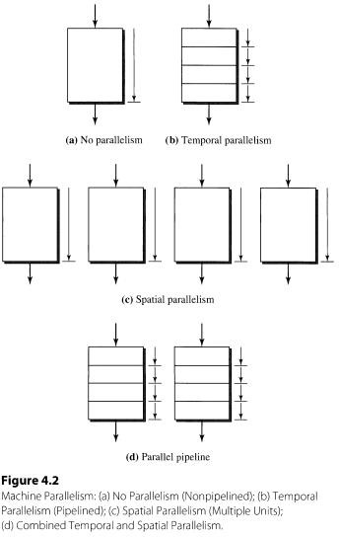
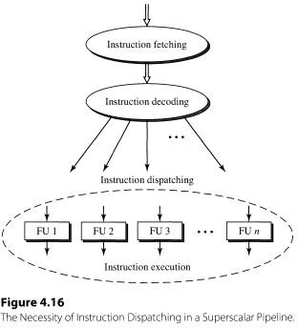
Machine Parallelism

Slide 10
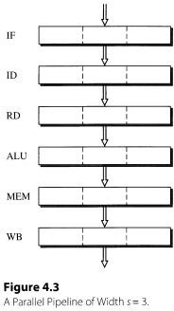
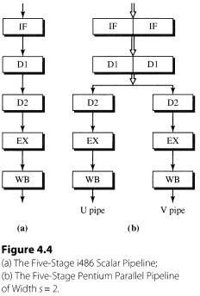
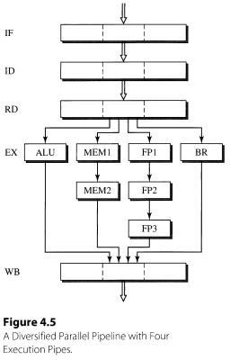
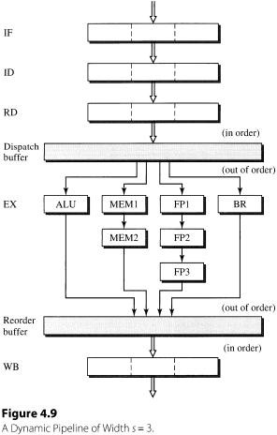
Simple Superscalar pipeline
With multiple execution parts ( pipelined )

Slide 11
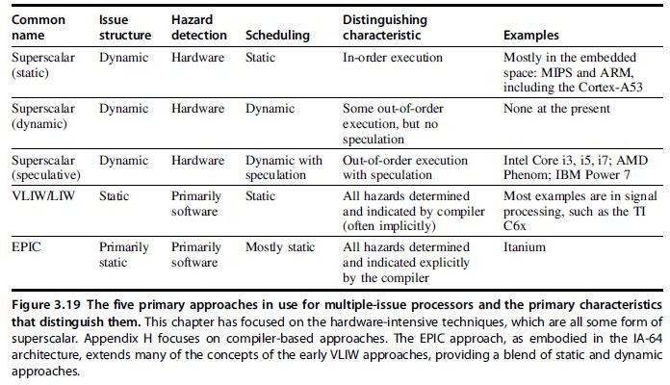
five approaches

Slide 12
Superscalar
Issue a varying number of instructions per clock cycle
Either statically scheduled by the compiler
Or dynamically scheduled by the hardware
using out-of-order execution(techniques like scoreboard, tomasulo)
VLIW
Issue a fixed number of instructions formatted either as
Inherently statically scheduled by the compiler

Slide 13
Superscalar vs. VLIW
Superscalar
Smaller code size
Good binary compatibility
VLIW
Simple hardware design for decoding and firing instructions
Need to access more registers, typically using multiple register files

Slide 14
problem of multi-issue
If Integer and FP operations are easily distinguishable combinations, then for such programs the ideal CPI = 0.5 if the following conditions are met:
50% of the program is FP operation
no correlation
If more commands are emitted at the same moment, the more difficult it is to decode and emit
VLIW
Longer instruction words can accommodate more operations
By definition, all operations in VLIW are combined at compile time and are independent of each other, i.e., they can be executed in parallel
For example,2 int operations，2 float ， 2 memory references, 1 branch instruction
use compilation technique scheduling to solve branching

Slide 15
DEMO
Presentor: Junfei Wang

